Slide 1
View and edit objects with Popups
October 24, 2014
Notes:
Guidewire training materials contain Guidewire proprietary information that is subject to confidentiality and non-disclosure agreements. You agree to use the information in this manual solely for the purpose of training to implement Guidewire software solutions. You also agree not to disclose the information in this manual to third parties or copy this manual without prior written consent from Guidewire. Guidewire training may be given only by Guidewire employees or certified Guidewire partners under the appropriate agreement with Guidewire.

Slide 2
Describe the functionality of popups
Create popups used to view and edit objects

Slide 3
Popup fundamentals
Create a popup

Slide 4
Locations
PCF Element
PCF element one can navigate to
Widget
Location
Atomic Widget
Container Widget
Location Group
Page
A location is a PCF element that a user can navigate to
Define how user navigates from one UI to the next UI
How many screens can it reference?
Where are screens rendered?
Is previous location remembered?
Wizard
Popup
Worksheet
Forward
Exit Point
Notes:
Both Widget and Location are conceptual representations in this diagram. There are no <Widget /> or <Location /> elements.
At the top-level, PCF elements are split between widgets and locations. A widget is a PCF element that is transformed into HTML and becomes a (potentially) visible element of the user interface. There are two broad categories of widgets:
Atomic widgets are the individual elements of the user interface that either display data (such as fields and cells in a list) or let users execute actions (such as buttons and menu items).
Container widgets group atomic widgets or other container widgets into logical groups.
A location is a PCF element that a user can navigate to. Locations determine how users move from one place in the application to some other place in the application.

Slide 5

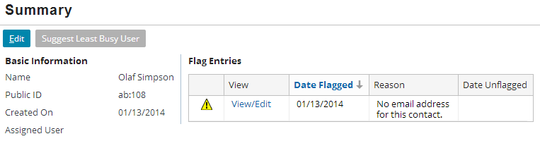
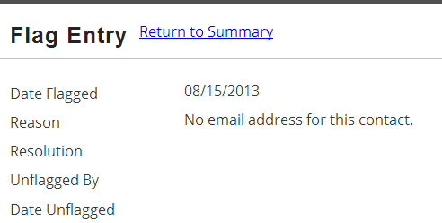
Popups
A popup contains a single screen and returns the user to the previous location once the popup is closed
Automatically has "Return to <previous location>" link
Notes:
In the slide example, the FlagEntryPopup popup is used to view existing flag entry objects and, if the user has sufficient permissions, edit them. However, it cannot be used to create flag entry objects. Flag entries are created only by the application business logic, not manually by a user.
The slide example shows a popup for a user with permissions to only be able to view the object data.

Slide 6
Why not use browser popup windows?
Many users configure their web browsers to block popups
Even if website or URL is from trusted source
Passing context and objects between browser windows can cause synchronization problems
Multiple popups open for same view
Popup window is left open while parent (main) window is closed
Guidewire popups
Provide almost all the functionality of true popup windows
Avoid blocking issues and synchronization problems
Notes:
Popup screens are designed to mimic the functionality of a true popup (which is an entirely separate window). True popups are difficult to architect because there is no easy way to avoid synchronization errors in which the system tries to update the same object in two separate windows. Popup locations as architected in Guidewire offer virtually the same functionality while avoiding the synchronization and usability issues.

Slide 7

Popup uses cases
View and Edit
Create New
Search
View and edit existing object
Create new object
Execute "popped" searches
Popup
Popup
Popup
Notes:
You can configure a popup to view and edit an object. You can configure a popup to create new objects. In most cases, the popup can both create new objects and view and edit existing objects. You can configure a popup to search for an existing record.

Slide 8
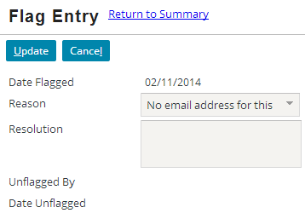
Example: View and edit existing objects
See notes for detailed explanation
Notes:
A popup can be used to view and edit an object. When it is either not convenient to edit the object in a location or some of the fields a user might wish to view and/or edit are not displayed in that location, you can use a popup. For example, a list view panel will often only display a limited number of object fields. Some of the cell widgets will be configured as navigation cell widgets. The navigation cells widgets will navigate to a popup so that a user can view and/or edit the object fields.
In the slide example, the FlagEntryPopup popup is used to view existing flag entry objects and, if the user has sufficient permissions, edit them. However, it cannot be used to create flag entry objects. Flag entries are created only by the application business logic, not manually by a user.
When a popup edits an existing object, the popup does not return the object to the parent list view. The parent list view panel already knows about the object, and the object already belongs to the array that is being displayed by the list view. Therefore, the popup simply commits and changes to the object in the database. The parent list view panel simply refreshes its information from the database.

Slide 9
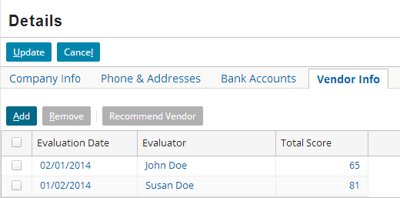
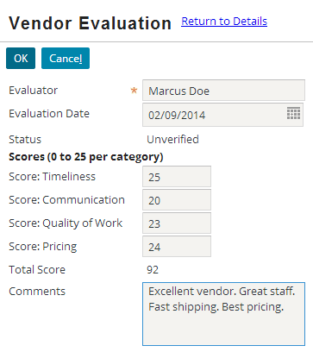
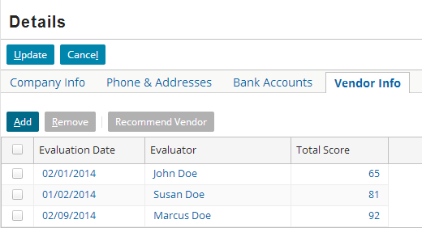
Example: Create new objects
See notes for detailed explanation
Notes:
You can configure a popup to create new objects. In most cases, the popup can both create new objects and view and edit existing objects.
When a popup creates a new object, the source container (often a list view panel) does not know about the object. The popup must return the object to the source container and the source must commit the object to the appropriate array that is associated with the parent object.

Slide 10
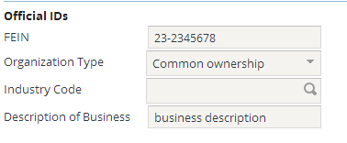
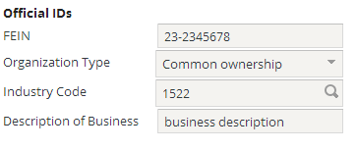
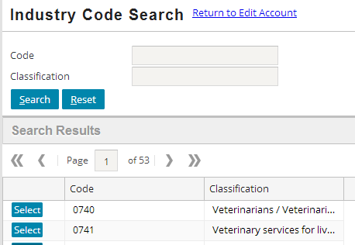
Example: Execute "popped" searches
See notes for detailed explanation
1522
Notes:
You can configure a popup to search for an existing record. When a record is located in some portion of the user interface where it would not be convenient to include search functionality, you will often see an implementation of a popped search.
An application needs a certain level of complexity and functionality to require a popped search. TrainingApp is simple enough that it does not have an example of this type of popup. The example shown above is from PolicyCenter, where a popup is provided to allow the user to search for a valid industry code when creating a new account.

Slide 11
Popup fundamentals
Create a popup

Slide 12
Steps to create a view/edit object popup
Create a popup PCF file
Specify variable(s)
Specify entry point(s)
Specify properties
Add containers and input widgets
Configure the navigation widget
Deploy PCFs

Slide 13
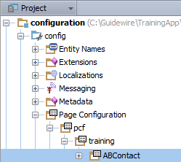
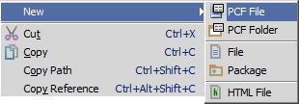
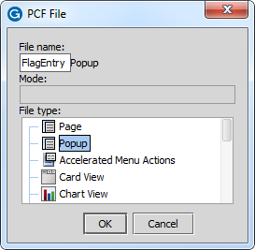
Step 1: Create a popup PCF
"Popup" appended to file name
In Project View, select a PCF Folder in …\config\ Page Configuration\pcf\
Context menu → New → PCF File
Enter the File Name and select Popup as the file type in PCF File dialog
Notes:
Studio automatically adds "Popup" to the end of the PCF file name.

Slide 14
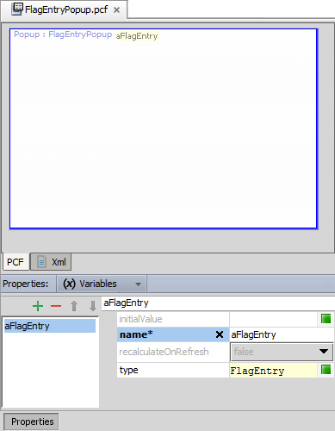
Step 2: Specify variable(s)
Variables tab
Defines data object variable name and type
Example: aFlagEntry is of type FalgEntry
Object data can be
Data backed (database)
Virtual property
Container data comes from defined variable object(s)
Referred to as root object
Notes:
A variable for a popup often serves as the root object for any containers that contains data fields. One way to think of this is that there is at least one root object for a given container. Root objects must be specified on the Popup's Variables tab.
The initial Popup location PCF file always displays an warning in the PCF Editor because the title attribute is required. In the slide example, the screenshot has been modified to not show the error.

Slide 15

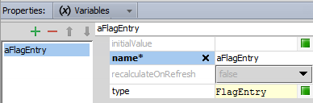
Step 3: Specify entry point(s)
An entry point is a reference used by widgets to navigate to a given location
Every location must have at least one entry point
Syntax: popupName(objName:objType)
Can specify multiple comma-delimited objects
Notes:
An entry point is a reference used by widgets to navigate to a given location. An entry point specifies the location name and the values required to render the location.
In the slide example, FlagEntryPopup is the entry point name. The name of the entry point must be the same as the name of the file in which the location is declared.
An entry point defines a signature. The syntax for a signature is the same as a Gosu method. A parameter is defined for the entry point, for example, aFlagEntry of the type FlagEntry. The parameter type is the same as the related variable for the Popup. In other words, every object referenced in the entry point signature must be declared as a variable in the Variables tab. In this manner, an FlagEntry object instance can pass as an argument to the Popup. It is possible to declare multiple comma delimited parameters in the signature definition.
Every location must have at least one entry point. Any given location can have many entry points. An example of this appears later in the lesson.

Slide 16
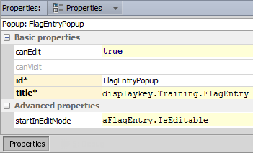
Step 4: Specify properties
id – identifier for popup
title – value for top label
canEdit – if false, no container or widget in location's screen is editable
canVisit – if false, no widget navigating to location is visible/clickable
startInEditMode – determines if popup starts in read-only or edit mode
Notes:
The title property determines the label in the top blue bar. In the slide example, the title is "Flag Entry".
Every location has a canEdit and canVisit property.
canEdit - This property determines if the screen and widgets contained in the screen are editable or not. If canEdit is false then the screen, every child container widget on the screen, and every atomic widget on the screen will not be editable.
canVisit - This property determines the behavior of widgets that navigate to the location. If it renders to false, then widgets that navigate to it are either not available or not visible. The specific behavior depends on the widget. For example, a cell widget that navigates to a location with its canVisit property set to false is visible but cannot be clicked. A menu item that navigates to a location with its canVisit property set to false is not visible.
The startInEditMode property determines if the popup is initially in edit mode or not. It can be set to a static value (true or false) or a Gosu expression, such as "aFlagEntry.IsEditable", which returns true if the flag entry is editable. (A flag entry is editable if it is open and the current user has "resolve flag entry" permissions.)

Slide 17
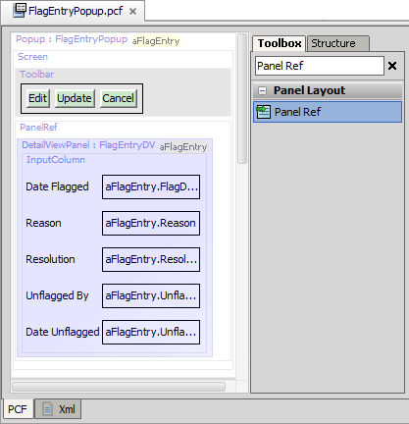
Step 5: Add containers and input widgets
Add Screen to popup
If editing…
Add Toolbar
Add Edit Buttons
Add inline container and input widgets OR
Add Panel Ref to reference other containers

Slide 18
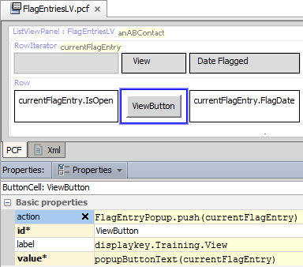
Step 6: Configure navigation widget
For the destination location, determine the entry point
Specify action property
push() method for popups
Syntax: locationName.push (objectList)
FlagEntryPopup.pcf
Notes:
The destination location is the file that you want the navigation widget to navigate to.

Slide 19
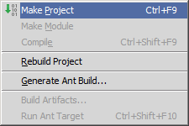
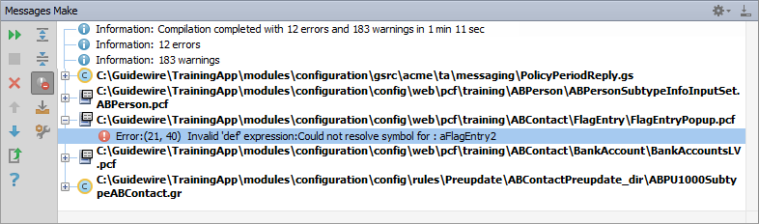
Make project to see all PCF errors
Build → Make Project
Compiles only modified files since the last compilation
Opens Messages (Make) window for build summary
Filter for errors
Great way to see all PCF errors
Notes:
Make Project: All the source files in the entire project that have been modified since the last compilation are compiled. Dependent source files, if appropriate, are also compiled. Additionally, the tasks tied to the compilation or make process on modified sources are performed.

Slide 20
Step 7: Deploy PCFs
Restart Server
Reload PCFs
PCFs read at server startup
ALT+SHIFT+L
Internal debug tools enabled
Internal Tools
Reload → Reload PCF Files
Page Configuration File
Popup PCF
Page Configuration File
Popup PCF
Notes:
It is also possible to reload PCF files using the Guidewire API and/or internal server tools. The Reload PCF command can be found on the Reload page in Internal Tools. To access Internal Tools, the EnableInternalDebugTools setting in the config.xml file must be set to true. The keystroke to open the Internal Tools page is ALT+SHIFT+T. In the tab bar, select Internal Tools --> Reload. On the Reload page, click the Reload PCF Files button. Both the keystroke ALT+SHIFT+L and the Reload PCF Files button call the same static method: gw.api.tools.InternalToolsUtil.reloadPCFs().

Slide 21
Describe the functionality of popups
Create popups used to view and edit objects

Slide 22
What are the three primary use cases for popups?
What happens if a location's canEdit property evaluates to false?
What happens if a location's canVisit property evaluates to false?
Notes:
Answers
1) Viewing and editing existing objects, creating new objects, and executing popped searches.
2) The screen and its contents are non-editable.
3) The widget navigating to the location is either not visible or not clickable.

